Slide 1
Virtual Job Fair v3.0 Team Members: Ana L. Hernandez Manuel Bouza Enio Peña Navarro Tomas Acosta Mentor: Masoud Sadjadi
CIS 4911 Senior Project
School of Computing and Information Sciences
Florida International University
July 25th, 2014

Slide 2
Problems and Limitations
Problem Definition
Recruiters are constantly seeking to increase the number of qualified candidates reached by their job postings.
FIU SCIS students would greatly benefit from a system which immediately notifies them of relevant jobs.
Current System problems / limitations
Primitive user authentication.
Students don’t benefit from external job opportunities.
Job search is lacking features.
Rudimentary administrative interface and notification system.

Slide 3
Tools and Methodologies
PHP Programming Language
Widely used for web development.
PHPStorm IDE
PHP/HTML/CSS/JavaScript Editor
Twitter Bootstrap
Front-end framework
JQuery
Flexible JavaScript library
Yii Framework:
Flexible MVC based PHP Framework
Built in DB Migration support.
MySQL DBMS:
Popular scalable database management system

Slide 4
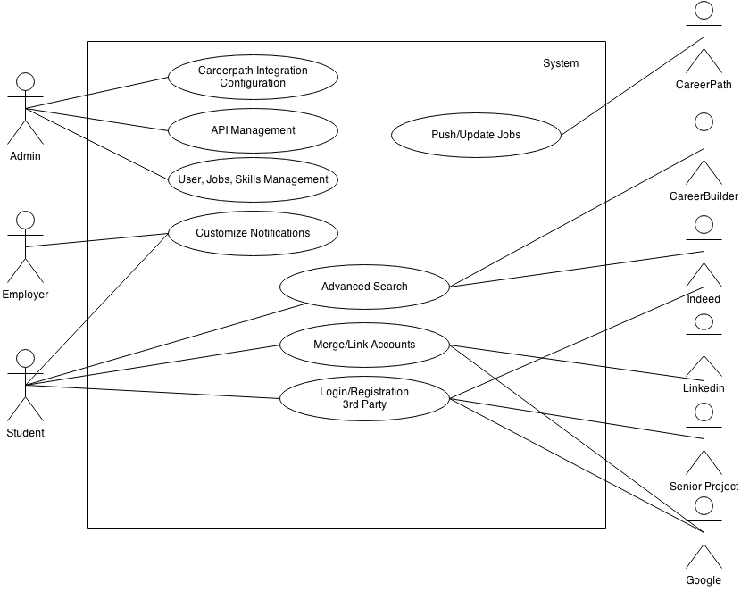
Use Case Diagram

Slide 5
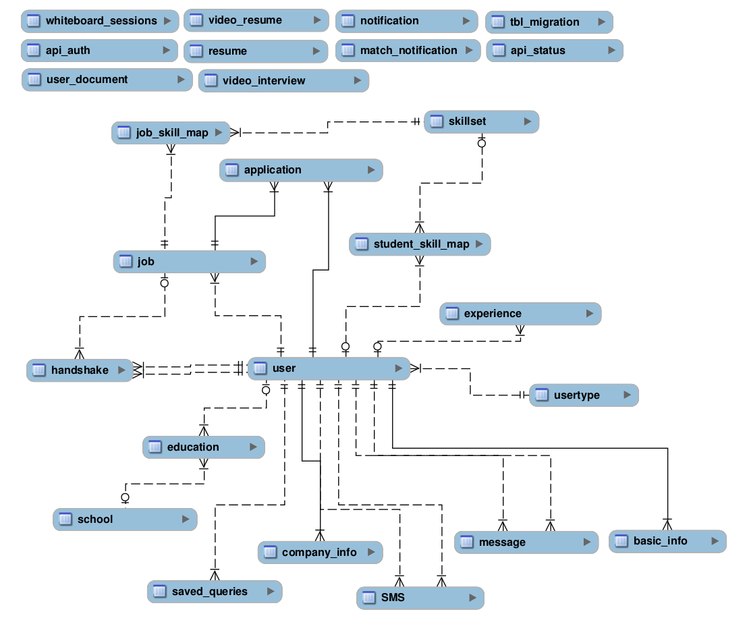
Database Design

Slide 6
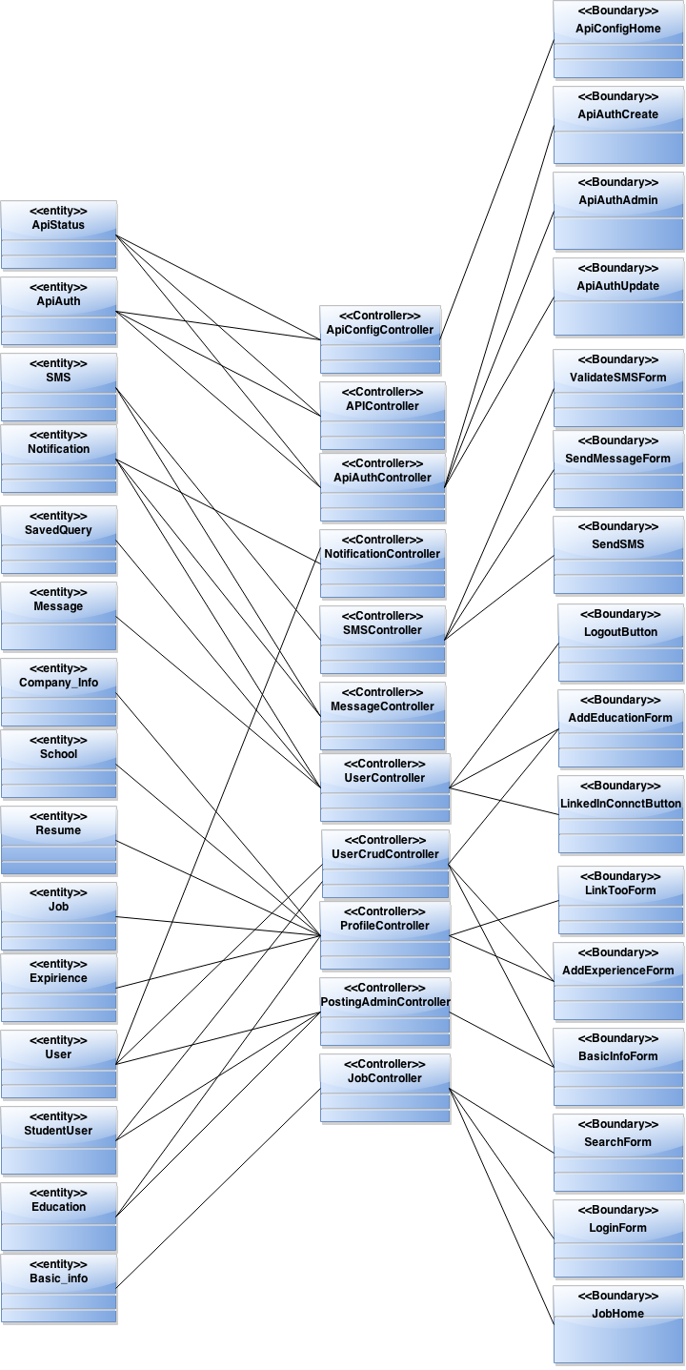
Minimal Class Diagram
Views
Models
Controllers

Slide 7
Minimal Class Diagram (Cont.)
Job Search & Administration
Messaging & Notifications
API Implementation

Slide 8
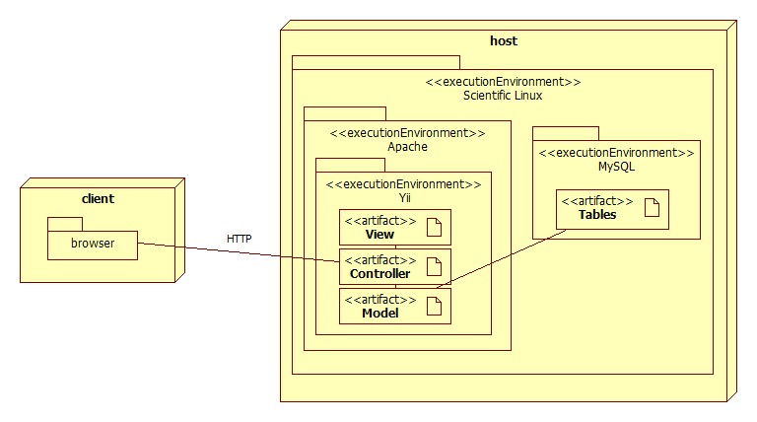
System Deployment

Slide 9
Use Case | VJF-067 Merge Account
Description | Provide the user with a view containing any merge conflicts generated during the account merging process.
Actor | Student
Pre-conditions | User must be logged in as Student.
Steps | User clicks on the ‘Merge Accounts’ button found in the navigation bar User enters the credentials for the account that he/she wants merge his current account with User chooses the information that he/she wants to keep User clicks on the ‘Fix Conflict’ button
Post-conditions | User is prompted with a notification letting him/her know that the merging process succeeded
Exceptions | User provides invalid credentials User account is disabled

Slide 10



Account Merging Process
VJF
VJF
VJF
Conflict Resolution
Conflict Resolution
Merge Successful

Slide 11


CareerPath API Integration
VJF
PUSH
BULK IMPORT

Slide 12
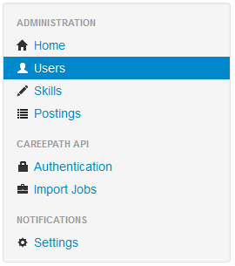
Administrative Interface
Manage:
Users
Skills
Postings
Configure:
CareerPath API
Notifications System

Slide 13
Use Case | VJF-057 Advanced search
Description | Allow students to search for job.
Actor | Student
Pre-conditions | User must be logged in as Student. User must be in the ‘Jobs’ page.
Steps | User fills the following fields: these words: +java this exact word or phrase: “developer” any of these words: full-time OR part-time none of these words: -php User selects the ‘Include jobs from outside sources’ checkbox Enters ‘Miami, Florida’ in the input box User clicks the ‘Search’ button
Post-conditions | Page reloads with job results from CareerPath, Indeed.com, and CareerBuilder.com.
Exceptions | No jobs matched the search criteria.

Slide 14
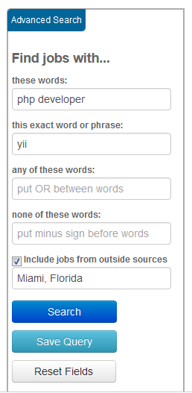
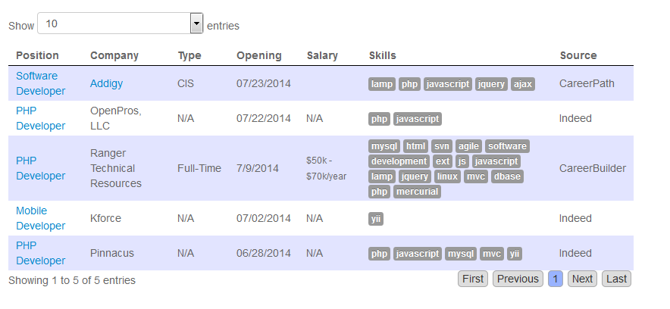
Advanced Search: Overview
Advanced Search Form:
Intuitive User Interface
Save Queries
Outside sources
Ranked results
Search Results:

Slide 15




Advanced Search: Save Query
Save Query
Complex Query
Email Results

Slide 16
Notifications: Overview
A system that enables the students to receive emails of job listings
Search queries
Student profile skill match
Configure notification settings
Time interval
A system that enable employers to receive emails listing students
Matching job posting description
Configure notification setting
A system that enable admin users to control the notification engine

Slide 17
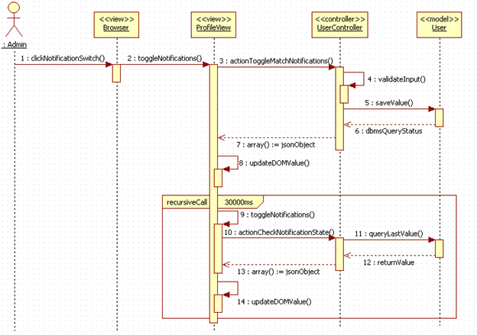
Notifications: Admin Interface

Slide 18

Notification Engine Flow
Command
Cronjob
(daily, weekly, monthly)
Notification Status
true
Fetch active students
Count = 0
Count < Students
false
true
Command exits
false
Student Match Notification Interval
true
false
Query job matches
Count++
YiiMailer
(SMTP wrapper)

Slide 19
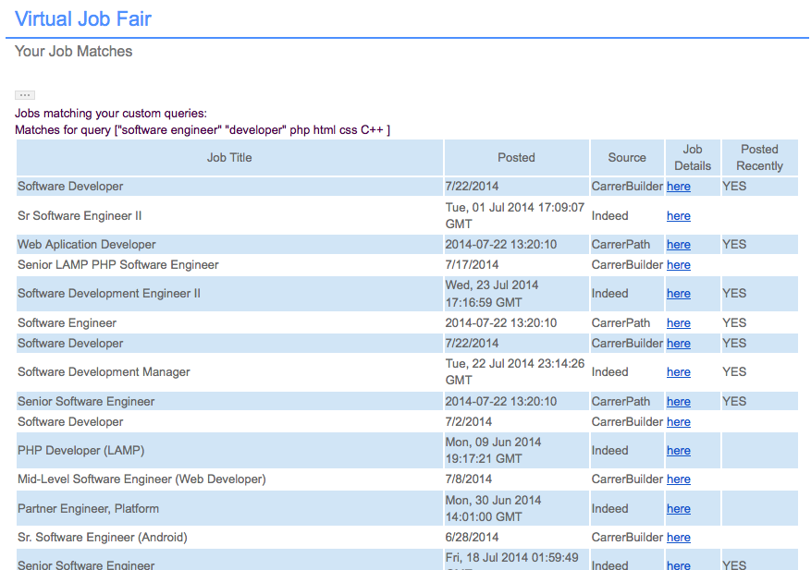
Notifications: Student Email

Slide 20
Security and Privacy
Privacy
Document repository hosted locally on FIU servers (Data is never sent to third parties).
Unix file permissions restrictions
Yii Access Control Rules restrictions
Security
XSS Mitigation
SQL Injection Mitigation

Slide 21
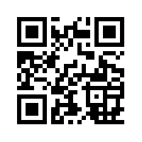

More Information
VJF
Checkout our system tutorial at:
http://bit.ly/fiuvjf
http://bit.ly/fiuvjfadmin

